Slide 1
Urban Traffic State Estimation by Fusing Multisource Information

Slide 2
Data fusion is important
Problem:
Difficult to provide complete and accurate traffic information just using one single data source
Each source of data (e.g. GPS location data, traffic cameras) has benefits and drawbacks, e.g. sparseness, error rate
Potential Applications:
Traffic management software to guide travelers
Validation of traffic simulations
Draw conclusions about relevance of fused datasets

Slide 3
Datasets Used For Traffic State Estimation
Dataset | Nature | Comments
Traffic Images | Real time | Use images provided by the LTA data-mall API to count the number of cars which is used as means to derive traffic density.
Floating car data | Historic | 100 million map-matched data points providing the following information. road-id, latitude, longitude, speed, time-stamp.
Loop detector data | Historic | Use loop detector data from several intersections which provide information on traffic flow and occupancy.
Traffic speed band | Real time | Traffic speed band data from the LTA data mall API.
eZLink | Historic | Data collected from eZLink smart cards providing service line, ride distance and travel time in buses.
Notes:
Mention lta dataMall

Slide 4
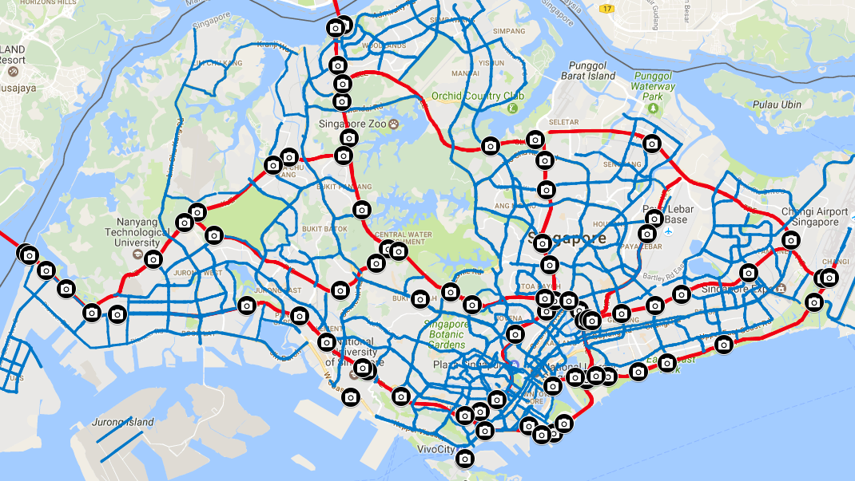
DataMall camera locations on
Singapore expressways
Notes:
78 cameras
17 on PIE
Focus on 3

Slide 5
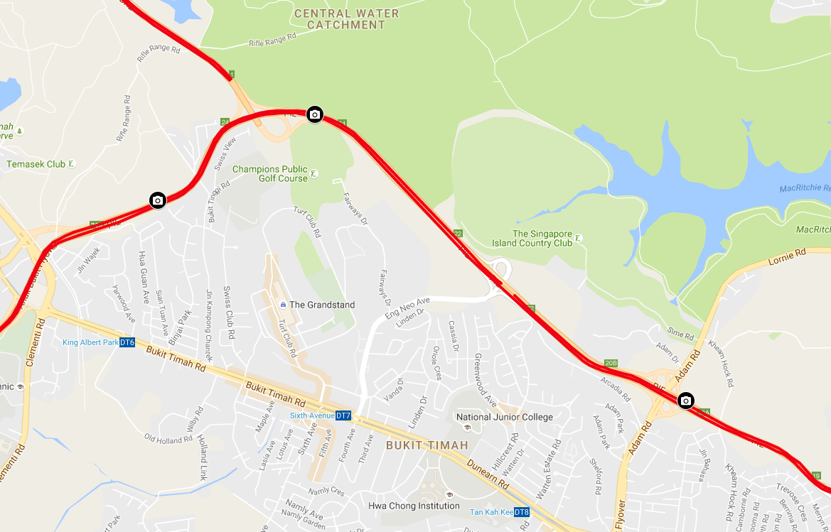
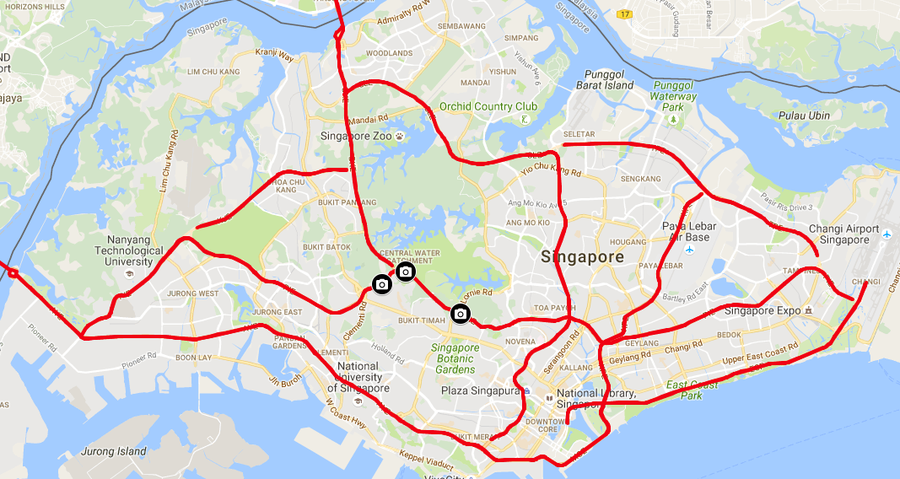

Slide 6
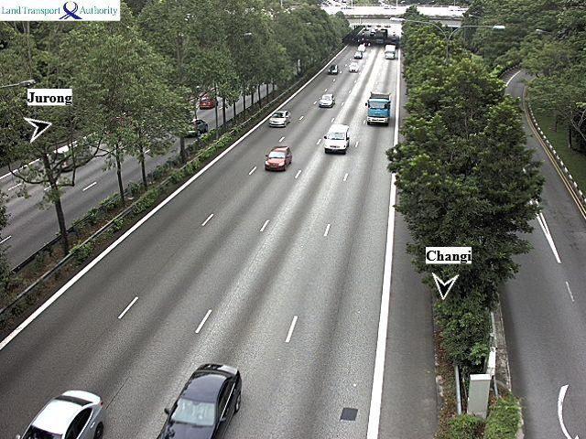
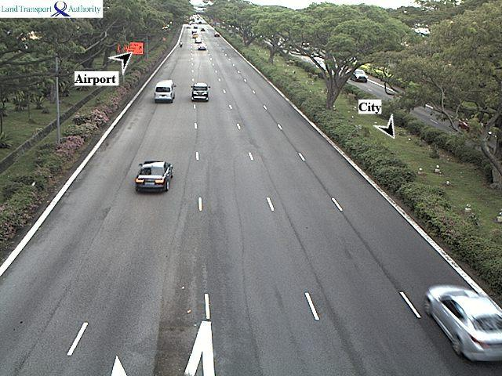
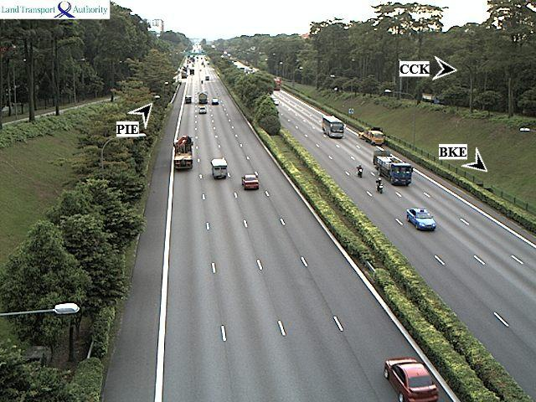
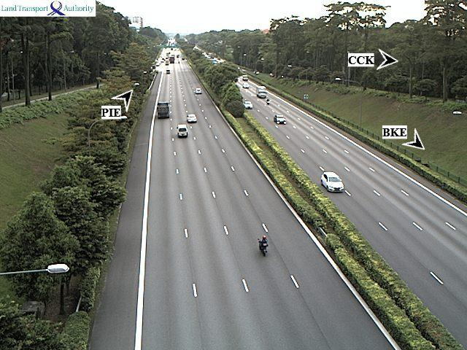
Cameras suitable for visual analytics

Slide 7
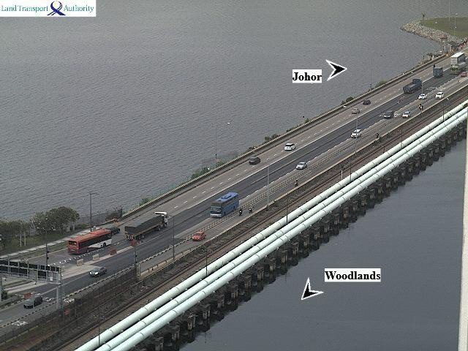
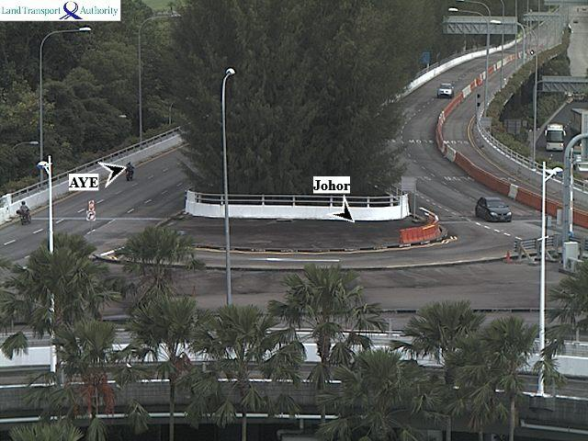
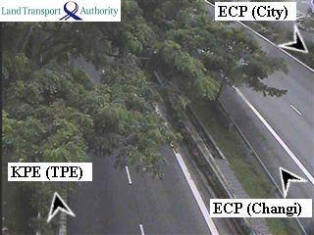
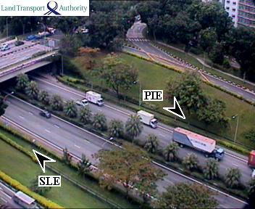
Difficult to analyze visually

Slide 8
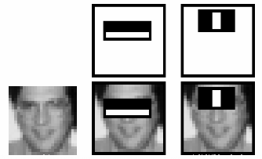

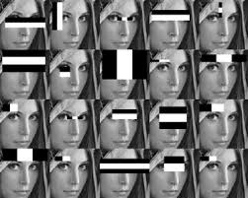
Detecting vehicles using HAAR features*
Apply Haar-feature to every input image
This results in a lot of features (>100000)
Use Adaboost to select the best features
* Rapid Object Detection using a Boosted Cascade of Simple Features, Paul Viola & Michael Jones, 2001

Slide 9
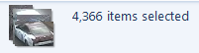
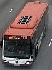
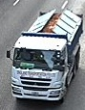
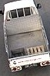
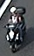
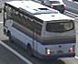
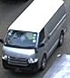
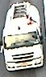
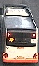
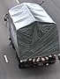
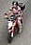
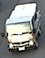
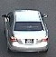
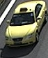
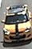
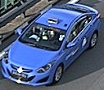
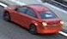
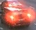
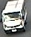
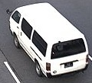
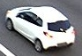

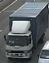
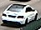
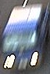
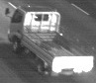
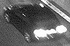
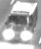



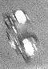
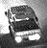



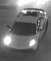

Positive Clipped Images

Slide 10

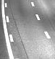

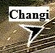
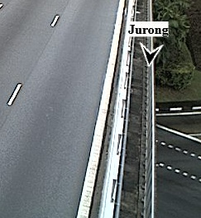
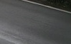


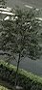
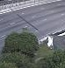

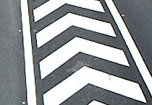















Negative Clipped Images

Slide 11


Saving road data for each camera
Save for each region of interest:
Mask as an array of points
Number of Lanes
Length of the lane

Slide 12

Adam Road (Cam ID: 6705)

Slide 13

Bukit Timah Expressway (Cam ID 6706)

Slide 14

Entrance from Jalan Anak Bukit (Cam ID 6710)

Slide 15




Traffic densities for P.I.E. camera ID 6705

Slide 16




From density to speed
Some models proposed in literature:
Study conducted on Singapore’s linked
arterial roads suggests*:
V = vf * exp(-0.07016 * k^0.75)
V: speed
vf: free flow speed calculated from QI
k: traffic density
*Speed-flow modeling of arterial roads in Singapore. Lum at al., 1998

Slide 17

Connecting datasets:
Mapping of camera ID to road ID

Slide 18

DataMall camera locations on Singapore expressways

Slide 19




Loop detector data
System used in Singapore:
SCATS (Sydney Coordinated Adaptive
Traffic System)
Implemented at intersections
Developed for over 40 years
Sold to 27 countries

Slide 20

Loop detector data collection
Data collected in collaboration with
the LTA over the course of a week
Gather data from ~300 intersections
which are classified as major in the
QI dataset
Obtain vehicle counts in 5 minute
intervals for each loop detector
Report of SCATS counts for 1 detector on 1 lane.
Columns refer to hour of day, rows to minutes.

Slide 21


Slide 22

Loop Detector Images

Slide 23

From vehicle counts to mean speeds
BPR formula:
Vr is the observed average speed on link r
VFr is the velocity in free flow conditions on link r
Notes:
α represents the ratio between free flow speed and speed at capacity
β determines how steeply the curve bends once the capacity is reached
γ captures the effect of speed reduction due to opposite traffic in roads with non-separated lanes

Slide 24


Quantum Inventions (QI) dataset specifications
GPS location data
9 weeks between 1st August 2014 and 1st October 2014
~ 100 million speeds extracted after map matching
Median ~25 seconds between consecutive timestamps
Form of data: (trackID, timestamp,
location, speed)

Slide 25

QI traffic state

Slide 26


Slide 27
Comparison of datasets
So far: speed extracted from every dataset
Now: compare different datasets:
Loop with QI on major roads
Camera with QI on expressways
Method: accumulate all data points for QI and loop detector and the last ~8 weeks for cameras in 15 minute intervals on given QI road segments and assume there is one traffic state

Slide 28



Comparison: camera - QI

Slide 29


Jurong West Ave 2 x Coorporation Rd

Slide 30

Correlation between QI and LOOP
α = 4.0
β = 1.8
Investigating uncertainty in BPR formula parameters The Næstved model case study

Slide 31

Use eZLink data for parameter estimation
Travel times and distances of buses can be derived from eZLink smart card data from 2013
Focus on bus service lines where there are a lot of QI and camera/loop detector data points
Concentrate on bus stops that are far apart to be sure the bus flows within the traffic
Service line 151

Slide 32

Data fusion workflow
A Fusion-Based System for Road-Network Traffic State Surveillance: A Case Study of Shanghai

Slide 33

Kalman filtering to reduce noise in data
The speeds we get from each data source are noisy!
Use Kalman filter to estimate the state of a discrete time controlled process

Slide 34
Data fusion workflow
A Fusion-Based System for Road-Network Traffic State Surveillance: A Case Study of Shanghai

Slide 35
Use Dempster Shafer Theory to fuse data
Goal: combine speeds (Loop detector, camera, QI) to estimate traffic state
DS – Theory provides a way to fuse floating point mean speeds into a set of
discrete traffic states
I use it as follows: aggregate all QI, Loop and camera speed data points on weekdays in 15 minute time intervals, smooth, fuse smoothed speeds to a discrete traffic state

Slide 36

QI - distribution of data points 14:00 – 14:15, Cam ID 6705

Slide 37

Camera - distribution of data points
14:00 – 14:15, Cam ID 6705

Slide 38
Example
DS- Theory Similar to probability theory but
incorporates the concept of ignorance
A murder has been committed. There are three suspects: Ω = {Peter, John, Mary}.
A witness saw the murderer going away in the dark, and he can only assert that it was man. How, we know that the witness is drunk 20 % of the time.
This piece of evidence can be represented by
m({Peter, John}) = 0.8,
m(Ω) = 0.2
The mass 0.2 is not committed to {Mary}, because the
testimony does not accuse Mary at all!

Slide 39


Practical Example for DS Combination
Every speed value gets assigned a certain mass (“probability”)
Fuse those masses according to rules provided by the theory

Slide 40



Fusion results in final state S4

Slide 41
Future work
Extract Parameters from eZLink dataset
Validation of fusion using traffic cameras and traffic speed band data
Estimation of the reliability of datasets in DS – theory
Validation of CityMOS

Slide 42
Relevant literature
A Fusion-Based System for Road—Network Traffic State Surveillance: A Case Study of Shanghai, Qing-Jie Kong et al.
An Approach to Urban Traffic State Estimation by
Fusing Multisource Information, Zhipeng Li at al.

